Slide 1
Mid Term Presentation

Slide 2
Induction process
Company standards and policies
IT induction – Top 12
New Employee Safety Training
Learn about the MPFM in SWTC
Notes:
Information that makes us unique from other companies will be lost
Safety causes a huge downtime
Q=v.A

Slide 3
Engineering Team
One of the many departments in SWTC; others would be supply chain, sustaining, manufacturing etc.
Develop other versions of the VX spectra that has the same functions but cheaper in price
MRL concept 5 – V-channel

Slide 4
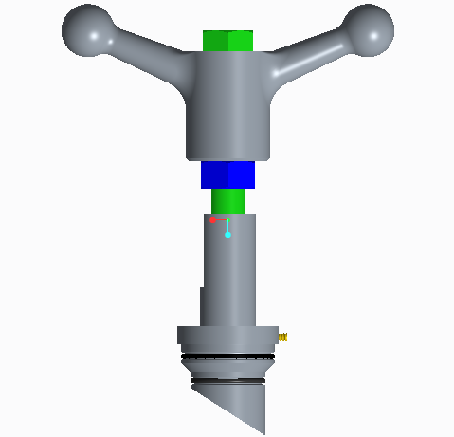
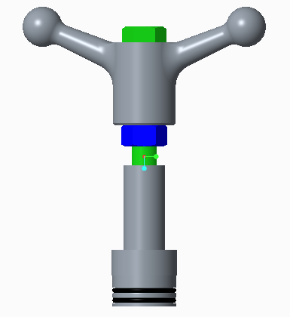
First project
Creo
Familiarisation of GEMS & ECO
Correction: ECO is a system???
Notes:
Requires me to use the basics, and made me aware of the intricacies of drawing
Be mindful of other people down the line
Good point to start with a cylinder to simulate manufacturing processes
Every product has to undergo layers of approvals before it can be passed/manufactured
Also, changes to the parts have to be approved by certain parties so that everyone is made aware of this change

Slide 5
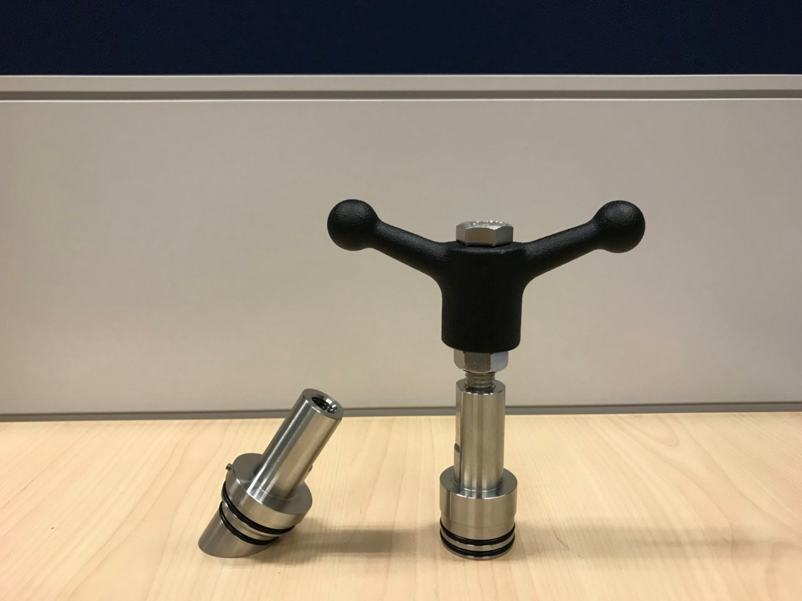

Slide 6
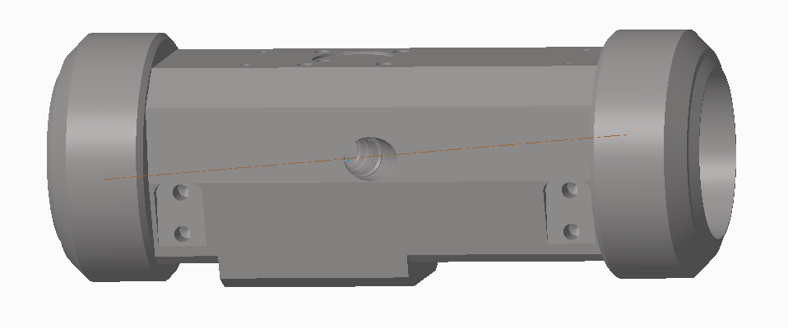
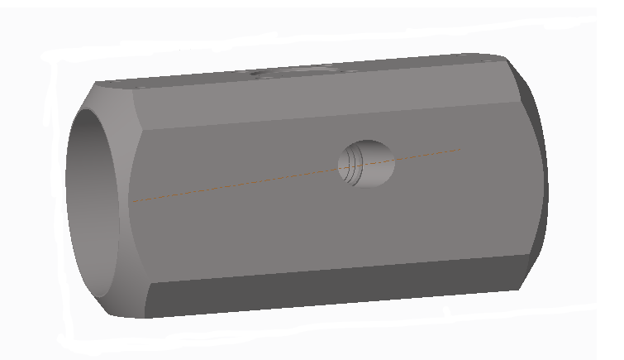
6-inch V-channel project
6-inch version of the prototype
Can the cost be reduced further?
Also ensures the continuation of the MRL project once it is passed to the sustaining team in the future
Notes:
Add my own features, design according to my own taste

Slide 7
FEA study
Learnt about the basis of FEA and why it is needed
Went through an extended thought process

Slide 8
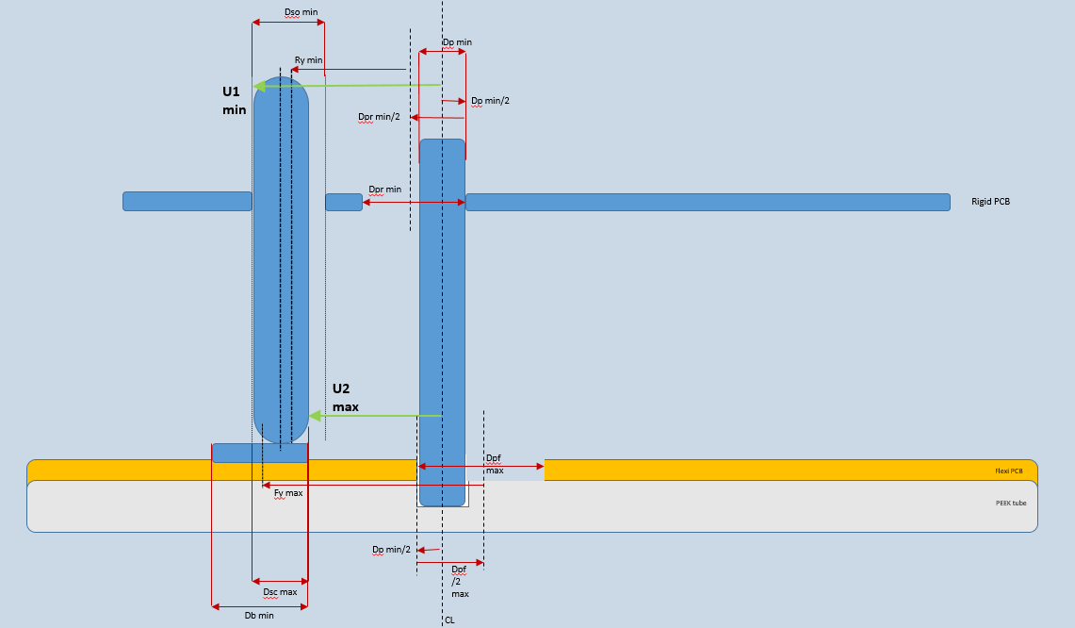

Tolerance analysis
Worst case analysis
Dimensioning

